Slide 1
Source Code Control
Kevin, Sameep, Bryan and Scott
May 21, 2014

Slide 2

Source code control should be extended in MIS with a low cost, effective solution
Current MIS source code control is managed in Perforce, in limited scale.
We piggyback on what is used by R&D.
This provides MIS little capability for managing use.
Ideally, we would like to find a lightweight source code control solution that MIS can get behind.
… and is easy for us to use - developer and BSA alike.

Slide 3

Consider the potential benefits of formalizing code control
Streamline deployment process across multiple instances (example: automate deployment across non production instances to support “dot release” QA environments)
Pull source code control capabilities into MIS at no cost beyond resource time
Extend source code control across MIS platforms
Allows for easier restores if necessary
Simplifies multi-user development
Easily maintain different versions of an application

Slide 4
Several factors in the solution lend itself to a suitable MIS approach
Git provides a free, competent solution to manage source code
Everything’s worked on local machine; a 2-step process is used to commit
Commit to master locally
Then commit local master to server master
Exclusive locks do not happen
Different governance schemes can be applied to control master version
Free for all
Gate keeper for master
Lieutenant and Governors (multiple people responsible for various modules)
Tagging can be implemented to create specific deployment files
Branching allows different developers to work on different parts of code and allows users to reconcile difference upon committing update. Branches could be setup as:
Versions
Instances (dev, test, prod)
No right answer, depends on what works best for team

Slide 5
To the layperson…
“In software development, Git /ɡɪt/ is a distributed revision control and source code management (SCM) system with an emphasis on speed.[4] Git was initially designed and developed by Linus Torvalds for Linux kernel development in 2005.
Every Git working directory is a full-fledged repository with complete history and full version tracking capabilities, not dependent on network access or a central server.
Git is free software distributed under the terms of the GNU General Public License version 2.”
- Wikipedia (http://en.wikipedia.org/wiki/Git_(software))

Slide 6

Free tools are available to setup distributed source code control environment
Setup GIT environment
http://git-scm.com/
Installs set of git commands to manage repository
Create github repository to share code tree
https://github.com/kevin-j-m/fedex-day
Users need to setup a git hub account
Setup “UI Wrapper”, an application that facilitates git commands and repository management
http://www.sourcetreeapp.com/download/
This provides a user-friendly interface to take advantage of
For more help, refer to online references such as
http://git-scm.com/book
http://git-scm.com/about/branching-and-merging
https://www.atlassian.com/git/tutorial/git-basics

Slide 7
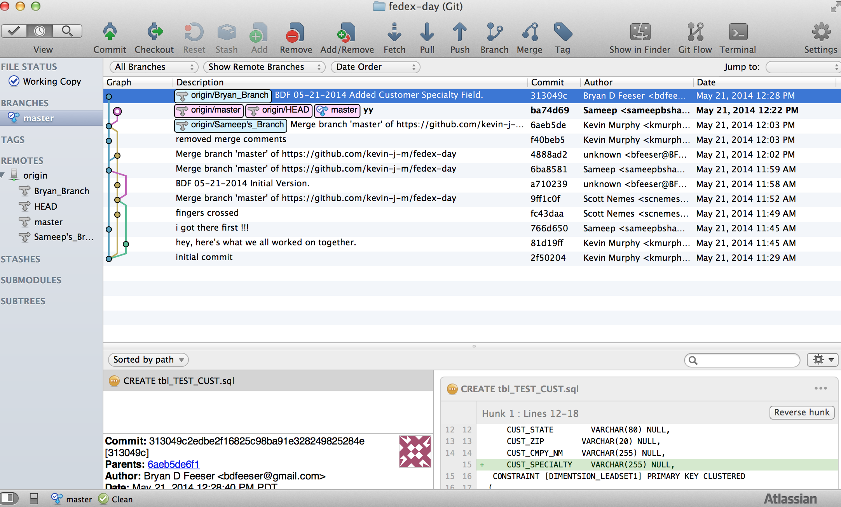
Let’s take a look… demo

Slide 8

Word on the street…
“It’s actually good!”
- As stated on 5/21 in regards to SourceTree

